Slide 1
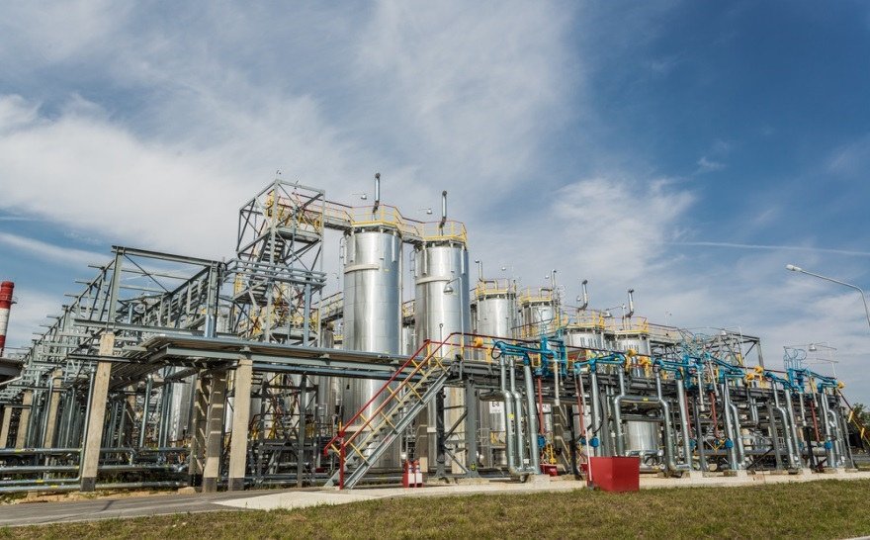
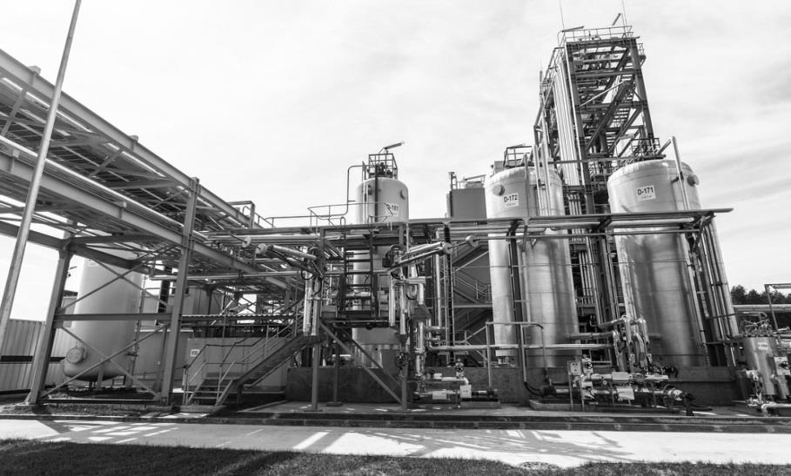
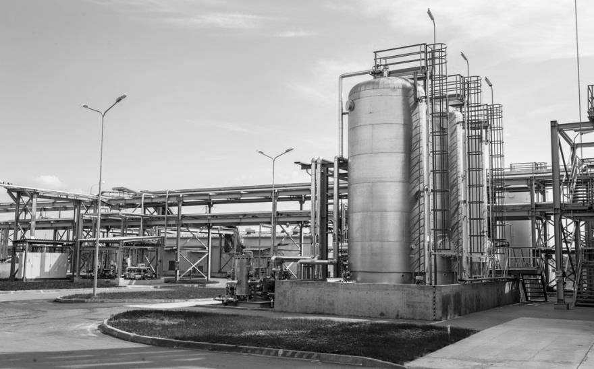
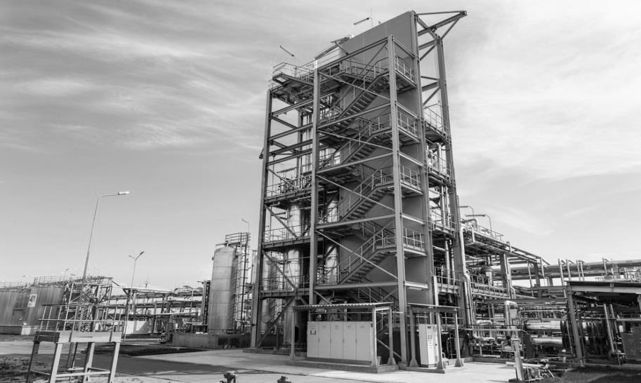
JSC “Mineral Wax Plant”
(BELWAX)

Slide 2
About company
JSC “Mineral Wax Plant” – manufacturer of oil products, and is an active member of Oil and Chemistry Holding of the Republic of Belarus.
Our company works on the market for more than 55 years and leader producer of paraffin waxes, candle waxes, paraffin emulsions.

Slide 3
People
Staff 291
113 people – under the age of 31
124 with high level of education

Slide 4
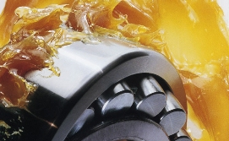
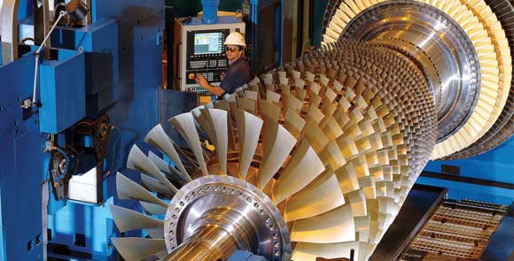
Product portfolio
Paraffin, candle waxes, high refinery candle waxes;
We produce waxes under French company license "Axens"
Protective waxes;
Paraffin emulsions;
We produce paraffin emulsions according lice9nse of Kronospan Technicals
Preservation oils and lubricants, cable lubricants;
Reagents for drilling;
Mould release and parting lubricants;
Lubricating and cooling technological agents;
Model compositions;
Greases.

Slide 5
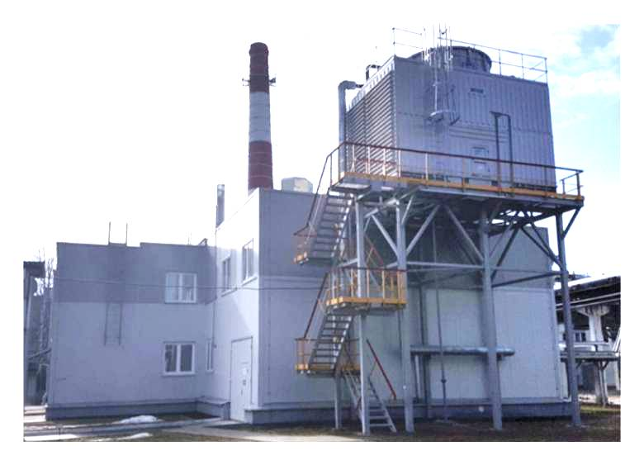
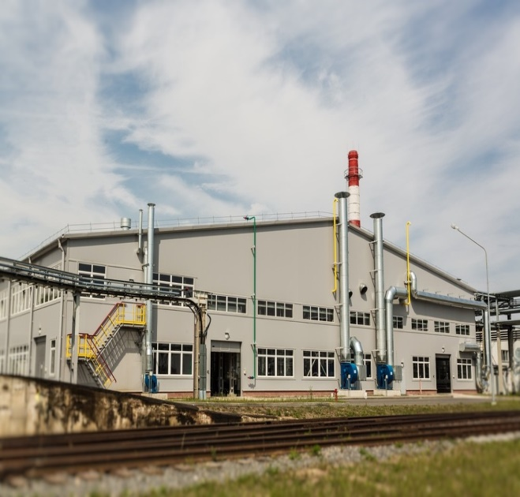
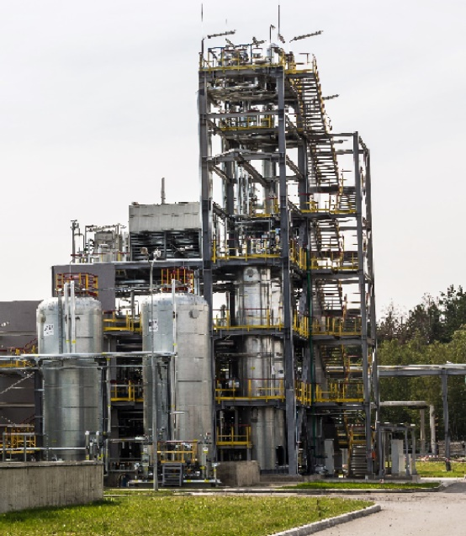
Implementation of investment project “The project on production fully refined paraffin wax, oils, lubricants, lubricating and cooling fluids, model compounds with reconstruction of the energy complex” (13.06.2013 - 30.09.2016)
Third step of implementation: Trigeneration complex with two gas engine generator with total energy capacity 2,99 MWth – 31.12.2015;
Second step of implementation: Production of oils, lubricants, lubricating and cooling fluids, model compounds with capacity 30 100 tons/year – 08.07.2016
First step of implementation : Production fully refined paraffin wax with capacity 20 000 tons/year – 30.09.2016.

Slide 6
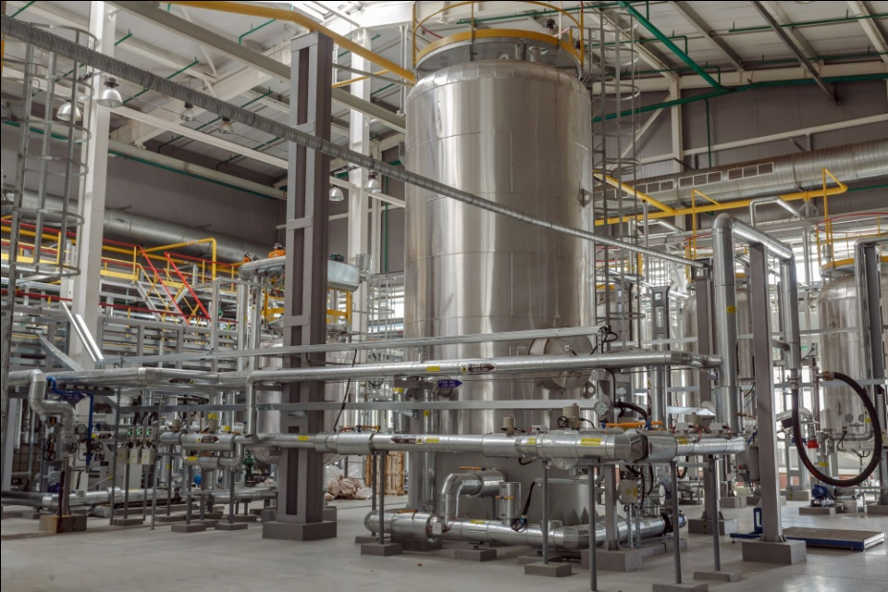
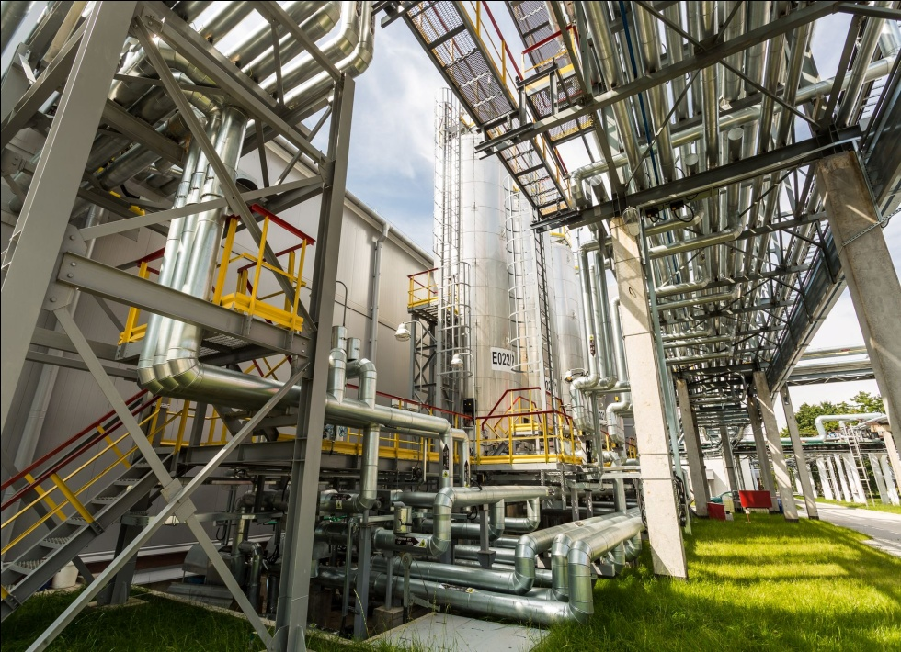
Production of oils, lubricants, lubricating and cooling fluids, model compounds
Capacity 30 100 tons/year
7 automated production and technological lines

Slide 7
Equipment
European producers equipment: SPX-Tapflo, KSB, Sandvik, Grundfos, IKA.
The production is equipped with automated control system.
Reactor equipment with a device for controlled intensive mass transfer.
Installation of granulation in the production of model compositions and protective waxes.
Automated lines of different packaging.
Flow pumps-mixers, dispersants, homogenizers, in the production of highly stable lubricating-cooling technological equipment and emulsions.

Slide 8
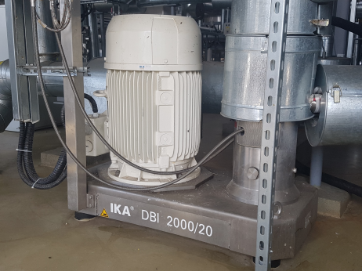
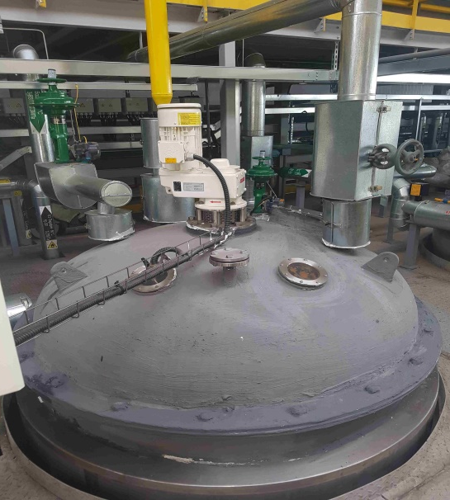
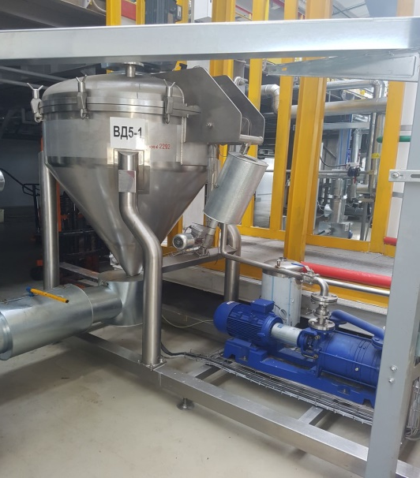
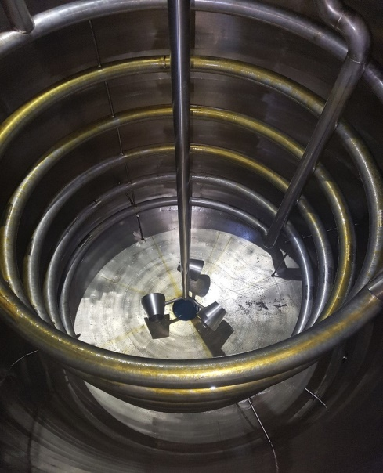
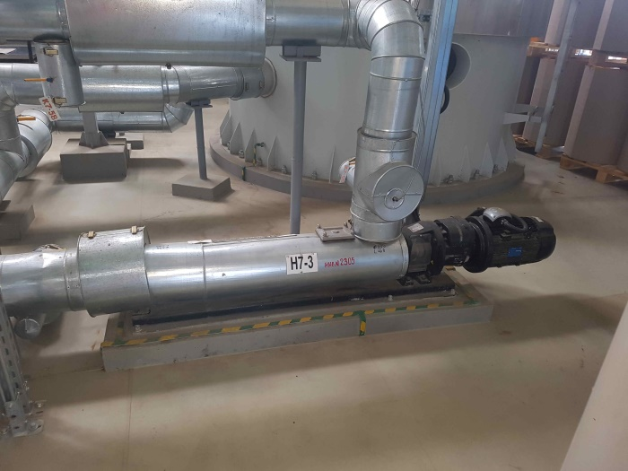
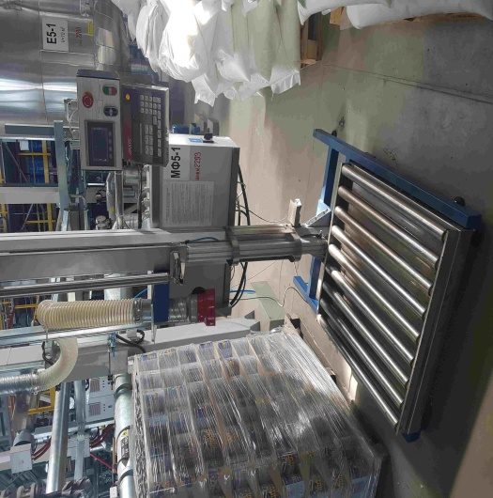
Equipment

Slide 9
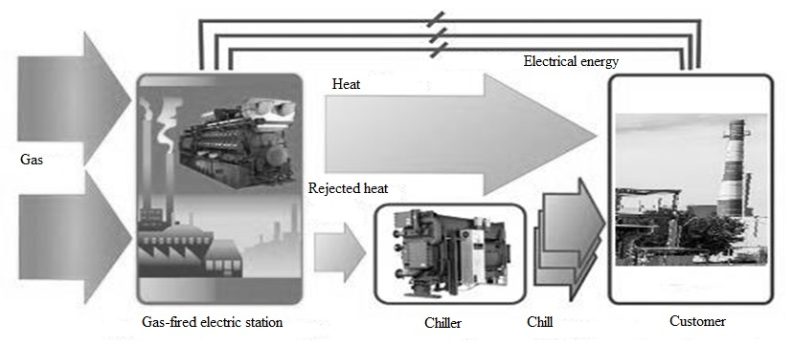
Energy complex
Production of fuel and energy resources
Steam : 0,6 MPa not over 185⁰С 1,2 MPa not over 240⁰С | 13 | tons/hour
Electric energy: 0,4 kWt | 2900 | kWt/hour
Cooled water: 7-14⁰С | 1000 | kWt
The production is equipped with a process automation system based on the Centrum VP system manufacturer of the world leader in this field Yokogawa (Japan)

Slide 10
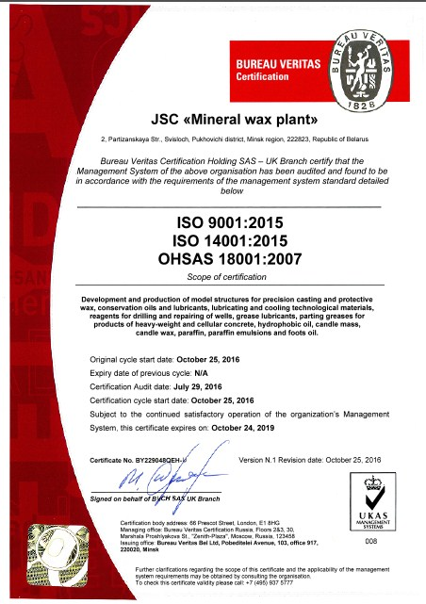
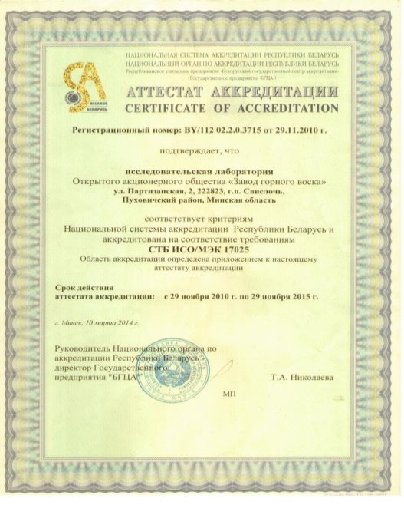
Accredited research laboratory
Modern automatics equipment (titrator, spectroscan, gas chromatograph, and etc.).
ASTM test methods.
Research and experimental works, development od new products, adjustment product composition.
Integrated management system require international standard
ISO 9001, ISO 14001, OHSAS 18001
(№ BY229048QEH-U)

Slide 11
Logistics
Profitable geographical location of
the our enterprise by:
proximity of two main ports: Klaipeda, Riga;
wide network of the automobile, railway and air roads;
two Pan European transport corridors: №2 and №9 going through the territory of the Republic of Belarus.
Delivery of finished products
of “Mineral Wax Plant” JSC by:
Automobile transport;
Railway transport;
Cargo Shipping;

Slide 12
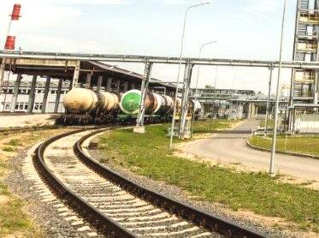
Logistics
An overhead loading platform:
6 receiving pipelines from a tank truck for various raw materials;
6 loading devices for loading products (various).
Railway drainage trestle: -2 module for heating refractory raw materials in railway tanks (gach, petrolatum); -6 drainage devices for various raw materials from railroads; -6 loading devices for loading railway tanks with different products; Storage capacity: -12 tanks (from 60 m3 to 80 m3) for various raw materials; -12 containers (from 60 m3 to 80 m3) of finished products.

Slide 13
Storage tank containers for raw materials and finishing products
Storage capacity for raw materials and finishing products - 1 680 м3.

Slide 14
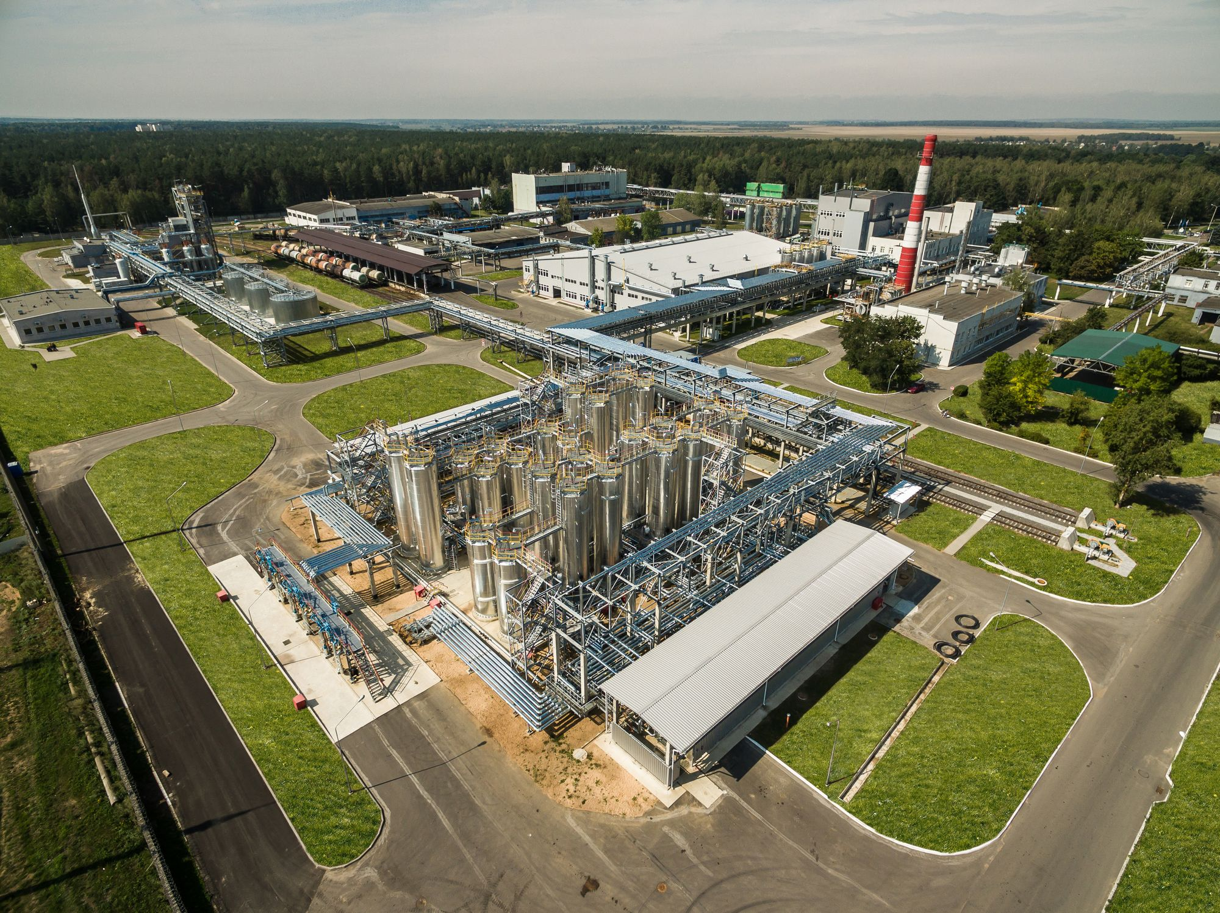
The territory of JSC “Mineral wax plant” (Belwax)

Slide 15
Offers for cooperation
Purchase of the license for production under a brand of your company by our plant
Creation of coproduction of perspective production
Sale of a package of additives to our company for possible application in production

Slide 16
BELWAX PARTNERSHIP IS A CHEMISTRY

